Slide 1
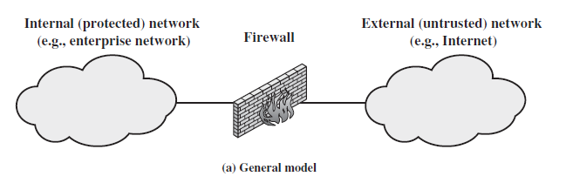
Chapter 20 – Firewalls
Notes:
Opening quote.

Slide 2
What is a Firewall?
Firewall provides perimeter defence like outer security wall to all systems in an organization
It is a single choke point where security & auditing policy can be imposed
Firewall can be implemented using software, hardware or both
Notes:
A firewall is inserted between the premises network and the Internet to establish a controlled link and to erect an outer security wall or perimeter, forming a single choke point where security and audit can be imposed. A firewall:
defines a single choke point that keeps unauthorized users out of the protected network, prohibits potentially vulnerable services from entering or leaving the network, and provides protection from various kinds of IP spoofing and routing attacks.
2. provides a location for monitoring security-related events
3. is a convenient platform for several Internet functions that are not security related, such as NAT and Internet usage audits or logs
4. A firewall can serve as the platform for IPSec to implement virtual private networks.
The firewall itself must be immune to penetration, since it will be a target of attack.

Slide 3
Characteristics of firewall
All traffic from inside to outside, and vice versa must pass through firewall
Firewall will allow only authorized traffic to pass.
Firewall must be immune to penetration

Slide 4
Capabilities of Firewall
It blocks unauthorised users from accessing protected network.
It prohibits vulnerable services from entering or leaving network and protects network from various types of attacks
It is auditing and controlling all accesses
  alarms for abnormal behavior
It provides NAT & audits/logs Internet usage
It implements VPNs using IPSec

Slide 5
Limitations of Firewall
cannot protect from attacks bypassing it
  eg sneaker net, utility modems, trusted organisations, trusted services (eg SSL/SSH)
cannot protect against internal threats
cannot protect against transfer of all virus infected programs or files as it is impractical to scan all.
Notes:
Firewalls have their limitations, including that they:
cannot protect against attacks that bypass the firewall, eg PCs with dial-out capability to an ISP, or dial-in modem pool use
2. do not protect against internal threats, eg disgruntled employee or one who cooperates with an attacker
3. cannot protect against the transfer of virus-infected programs or files, given wide variety of O/S & applications supported

Slide 6
Types of Firewall
Packet filtering router
Application level gateway
Circuit level gateway

Slide 7
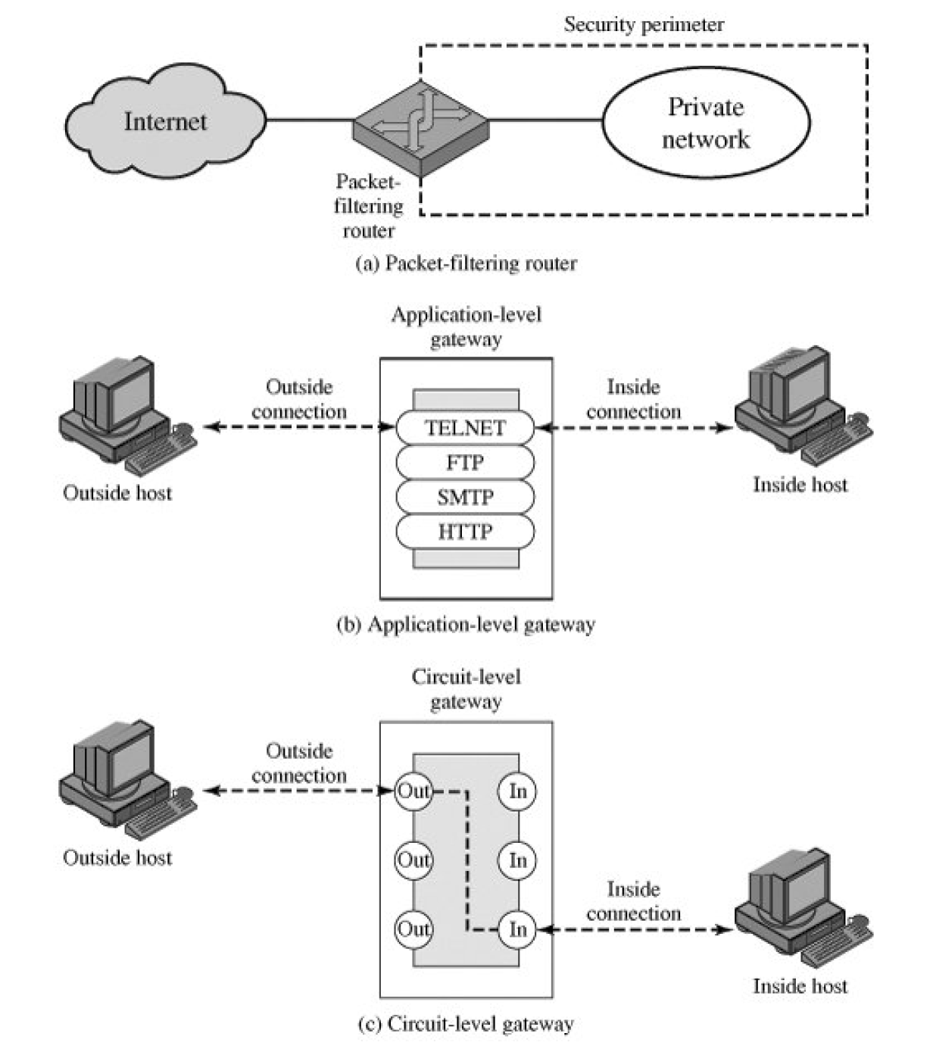

Slide 8
Firewalls – Packet Filters
simplest, fastest & transparent type of firewall
foundation of any firewall system
examines each IP packet (in both directions) and permit or deny according to rules
default policies are:
  Default=Discard - that which not explicitly permitted is prohibited
  Default=forward - that which is not explicitly prohibited is permitted
Notes:
Have three common types of firewalls: packet filters, application-level gateways, & circuit-level gateways.
A packet-filtering router applies a set of rules to each incoming and outgoing IP packet to forward or discard the packet. Filtering rules are based on information contained in a network packet such as src & dest IP addresses, ports, transport protocol & interface. Some advantages are simplicity, transparency & speed.
If there is no match to any rule, then one of two default policies are applied:
• that which is not expressly permitted is prohibited (default action is discard packet), conservative policy
• that which is not expressly prohibited is permitted (default action is forward packet), permissive policy

Slide 9
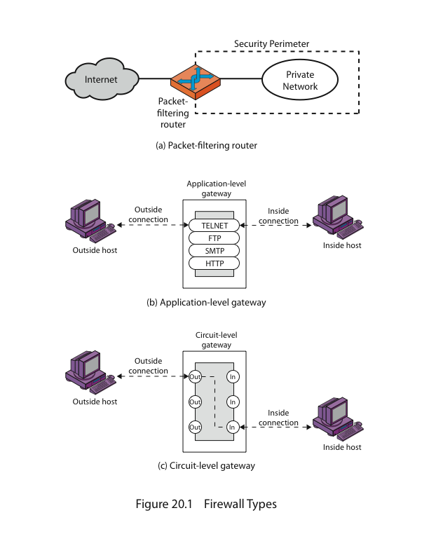
Firewalls – Packet Filters
Notes:
Stallings Figure 20.1a illustrates the packet filter firewall placement in the border router, on the security perimeter, between the external less-trusted Internet, and the internal more trusted private network.

Slide 10
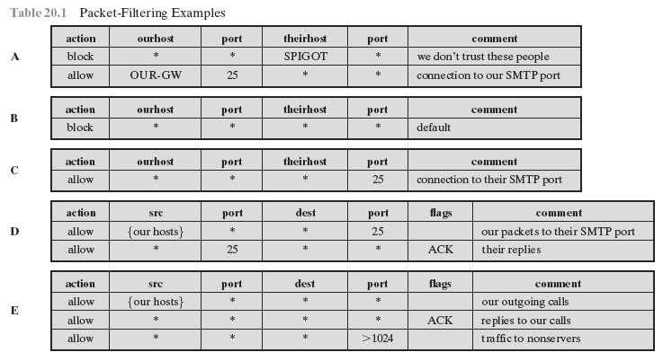
Firewalls – Packet Filters
Notes:
Stallings Table 20.1 gives some examples of packet-filtering rule sets. In each set, the rules are applied top to bottom.
A. Inbound mail is allowed to a gateway host only (port 25 is for SMTP incoming
B. explicit statement of the default policy
C. tries to specify that any inside host can send mail to the outside, but has problem that an outside machine could be configured to have some other application linked to port 25
D. properly implements mail sending rule, by checking ACK flag of a TCP segment is set
E. this rule set is one approach to handling FTP connections

Slide 11
Attacks on Packet Filters
IP address spoofing
  fake source address to be trusted
  add filters on router to block
source routing attacks
  attacker sets a route other than default
  block source routed packets
tiny fragment attacks
  split header info over several tiny packets
  either discard or reassemble before check
Notes:
Some of the attacks that can be made on packet-filtering routers & countermeasures are:
• IP address spoofing: where intruder transmits packets from the outside with internal host source IP addr, need to filter & discard such packets
• Source routing attacks: where source specifies the route that a packet should take to bypass security measures, should discard all source routed packets
• Tiny fragment attacks: intruder uses the IP fragmentation option to create extremely small fragments and force the TCP header information into a separate fragments to circumvent filtering rules needing full header info, can enforce minimum fragment size to include full header.

Slide 12
Application Level Gateway (or Proxy server)
Acts as a relay of application level traffic.
  user requests service from proxy
  proxy validates request as legal
  then forwards request to remote host and returns result given by remote host to user
It is more secure and simpler than packet filters.
  It can log / audit traffic at application level
Notes:
An application-level gateway (or proxy server), acts as a relay of application-level traffic. A user contacts the gateway to access some service, provides details of the service, remote host & authentication details, contacts the application on the remote host and relays all data between the two endpoints. If the gateway does not implement the proxy code for a specific application, then it is not supported and cannot be used. Note that some services naturally support proxying, whilst others are more problematic. Application-level gateways tend to be more secure than packet filters, &can log and audit traffic at application level.

Slide 13
Application Level Gateway
(or Proxy server)
Notes:
Stallings Figure 20.1b illustrates an application-level gateway (or proxy server), emphasizing that it only supports a specific list of application services.

Slide 14
Firewalls - Circuit Level Gateway
It does not permit end-to-end TCP connection
It sets up two TCP connections. One between gateway & internal host and another between gateway & external host
once connections are created, it relays traffic without examining contents
Security function determines which connections are allowed
typically used when internal users are trusted by allowing outbound connections without examining contents
Notes:
A circuit-level gateway relays two TCP connections, one between itself and an inside TCP user, and the other between itself and a TCP user on an outside host. Once the two connections are established, it relays TCP data from one connection to the other without examining its contents. The security function consists of determining which connections will be allowed. It is typically used when internal users are trusted to decide what external services to access.
One of the most common circuit-level gateways is SOCKS, defined in RFC 1928. It consists of a SOCKS server on the firewall, and a SOCKS library & SOCKS-aware applications on internal clients.

Slide 15
Circuit Level Gateway
Notes:
Stallings Figure 20.1c illustrates a circuit-level gateway, showing how it relays between 2 TCP connections. Note that it can be implemented in a stand-alone system or can be a specialized function in an application-level gateway for certain applications. Note also that relaying UDP packets is more problematical, because of the lack of connection context, and require a parallel TCP connection to provide these details.

Slide 16
Bastion Host
highly secured host
runs circuit / application level gateways
or provides externally accessible services
potentially exposed to "hostile" elements
hence is secured to withstand this
  hardened O/S, essential services, extra auth
Notes:
A bastion host is a critical strong point in the network’s security, serving as a platform for an application-level or circuit-level gateway, or for external services. It is thus potentially exposed to "hostile" elements and must be secured to withstand this. Common characteristics of a bastion host include that it:
• executes a secure version of its O/S, making it a trusted system
• has only essential services installed on the bastion host
• may require additional authentication before a user is allowed access to the proxy services
• is configured to support only a subset of the standard application’s command set, with access only to specific hosts
• maintains detailed audit information by logging all traffic
• has each proxy module a very small software package specifically designed for network security
• has each proxy independent of other proxies on the bastion host
• have a proxy performs no disk access other than to read its initial configuration file
• have each proxy run as a nonprivileged user in a private and secured directory
A bastion host may have two or more network interfaces (or ports), and must be trusted to enforce trusted separation between these network connections, relaying traffic only according to policy.

Slide 17
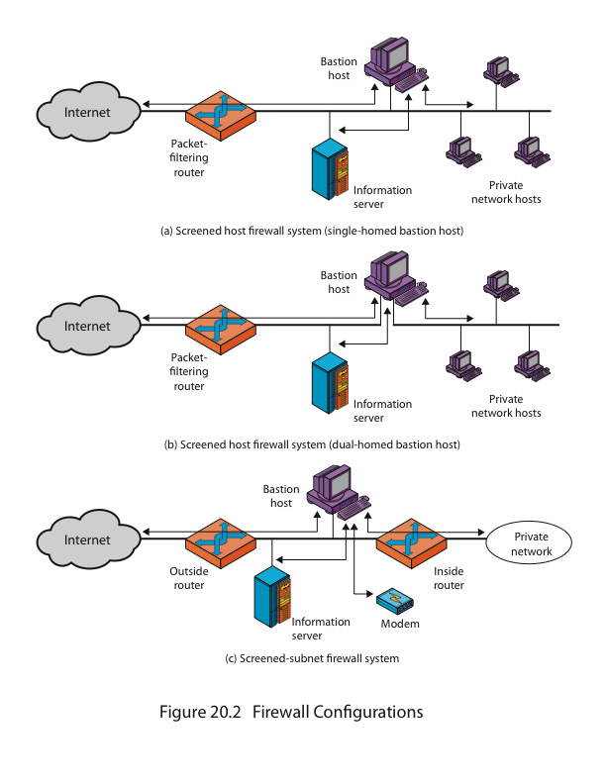
Firewall Configurations
Notes:
In addition to the use of a simple configuration consisting of a single system, more complex configurations are possible and indeed more common. Stallings Figure 20.2 illustrates three common firewall configurations.
Figure 20.2a shows the “screened host firewall, single-homed bastion configuration”, where the firewall consists of two systems:
a packet-filtering router - allows Internet packets to/from bastion only
a bastion host - performs authentication and proxy functions
This configuration has greater security, as it implements both packet-level & application-level filtering, forces an intruder to generally penetrate two separate systems to compromise internal security, & also affords flexibility in providing direct Internet access to specific internal servers (eg web) if desired.

Slide 18
Firewall Configurations
Notes:
Stallings Figure 20.2b illustrates the “screened host firewall, dual-homed bastion configuration” which physically separates the external and internal networks, ensuring two systems must be compromised to breach security. The advantages of dual layers of security are also present here. Again, an information server or other hosts can be allowed direct communication with the router if this is in accord with the security policy, but are now separated from the internal network.

Slide 19
Firewall Configurations
Notes:
Stallings Figure 20.2c shows the “screened subnet firewall configuration”, being the most secure shown. It has two packet-filtering routers, one between the bastion host and the Internet and the other between the bastion host and the internal network, creating an isolated subnetwork. This may consist of simply the bastion host but may also include one or more information servers and modems for dial-in capability. Typically, both the Internet and the internal network have access to hosts on the screened subnet, but traffic across the screened subnet is blocked.
This configuration offers several advantages:
• There are now three levels of defense to thwart intruders
• The outside router advertises only the existence of the screened subnet to the Internet; therefore the internal network is invisible to the Internet
• Similarly, the inside router advertises only the existence of the screened subnet to the internal network; hence systems on the inside network cannot construct direct routes to the Internet

